Slide 1
Expedia Hotel Recommendation
Rankings & Sentiment Analysis
Presented by:
Hari Panjwani
Tarun Keswani
Akash Bhatia
TEAM - 8

Slide 2
Problem Statement
Recommending best hotel group for a query
Ranking hotels based on parameters
User review - sentiment analysis
Real time review consideration

Slide 3
Dataset Information
Expedia hotel group recommendation
37.67 million records (train dataset)
2.5 million records (test dataset)
Expedia hotel rankings
9.9 million records (train dataset)
6.6 million records (test dataset)
Hotel reviews – sentiment analysis
1,36,000 records

Slide 4
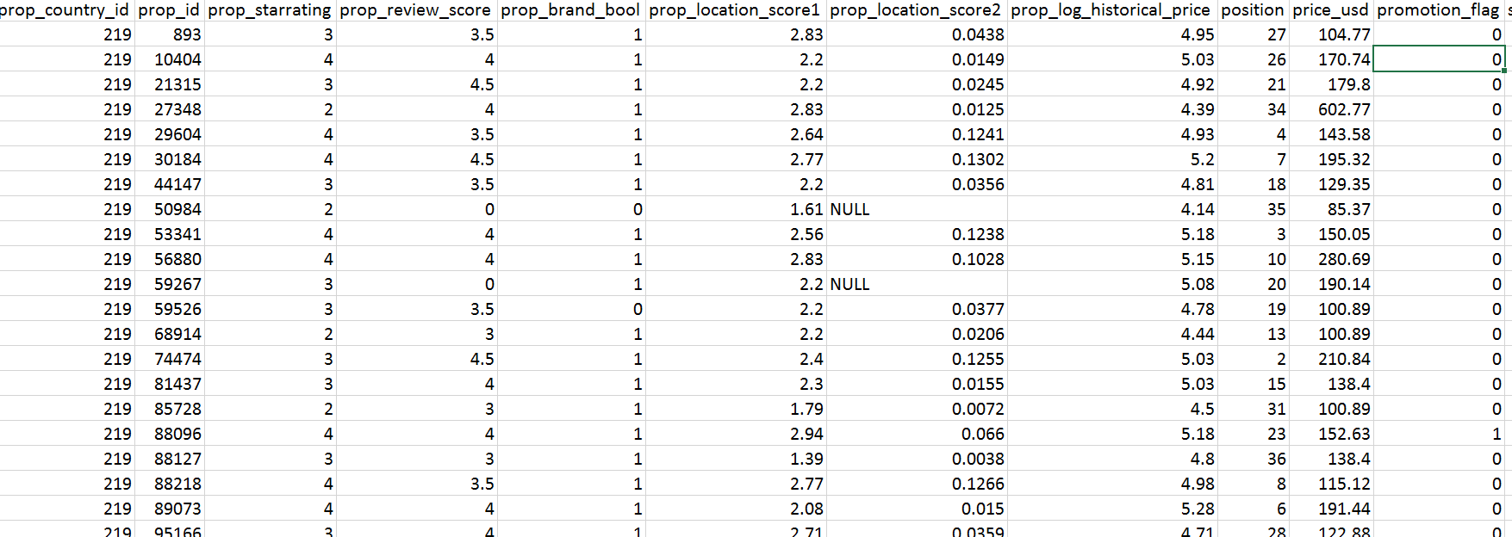
Quick Glimpse

Slide 5
Features
Hotel characteristics
Location popularity of hotel
Is a part of hotel chain
User sentiment review score
Location from where query initiates
Search parameters like
Travel period – number of days
Room requirement – number of rooms
Destination of the query
Whether a part of package

Slide 6
Data Analysis
Continent-wise number of bookings over several months
Click-Booking rate
Marketing Channel Performance
Comparison of Business from various Expedia sites

Slide 7
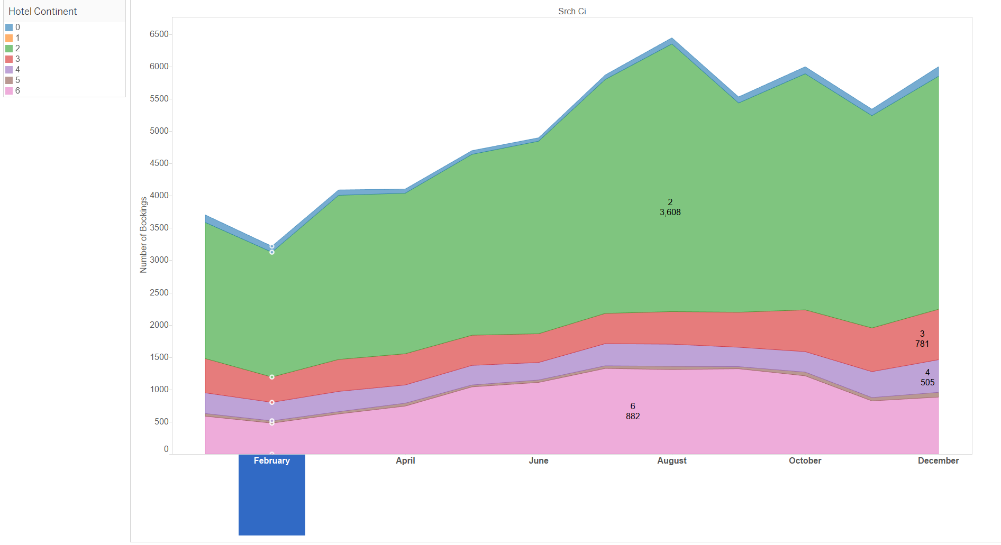
Continent-wise bookings over time

Slide 8
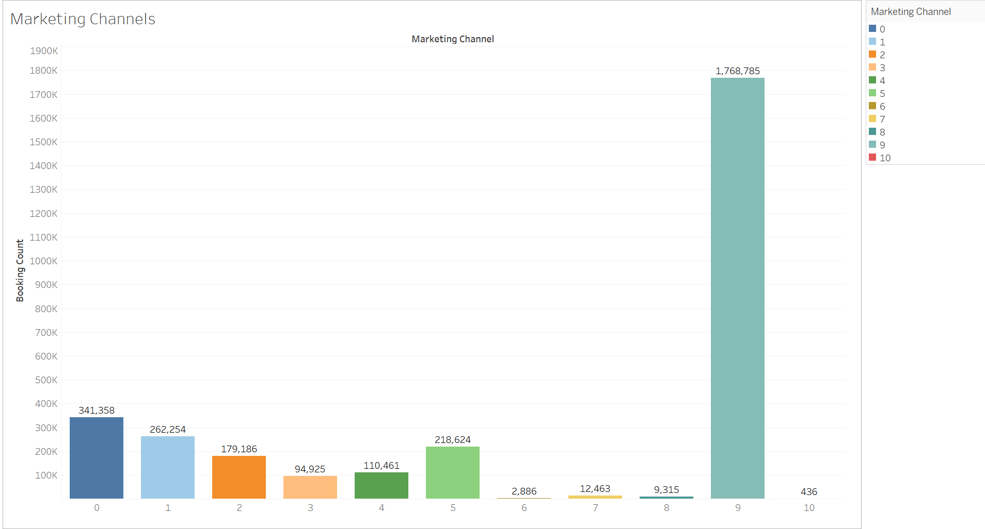
Marketing Channel Performance

Slide 9
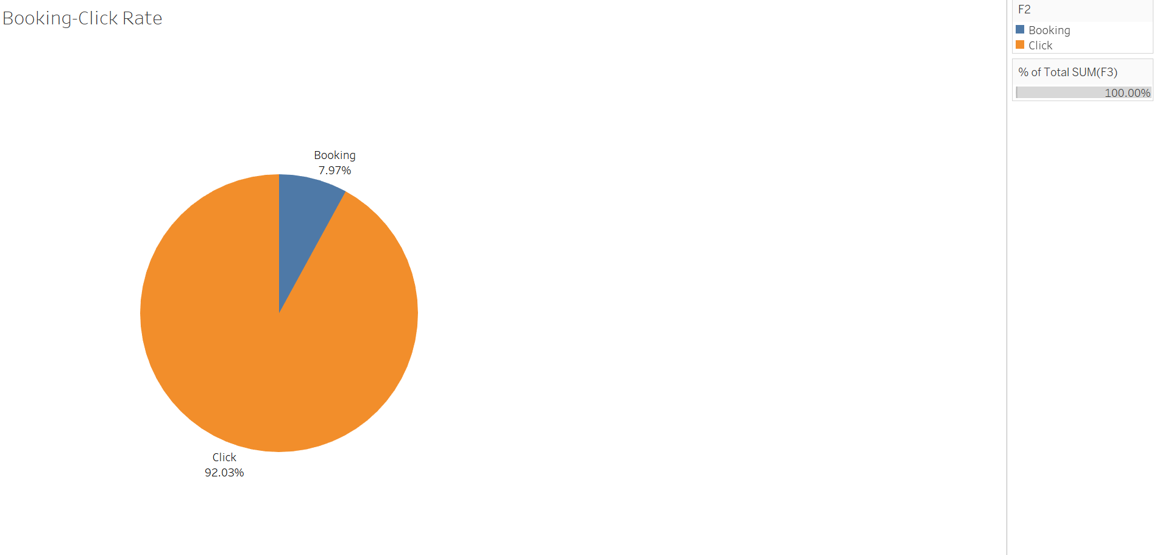
Click vs Booking Rate

Slide 10
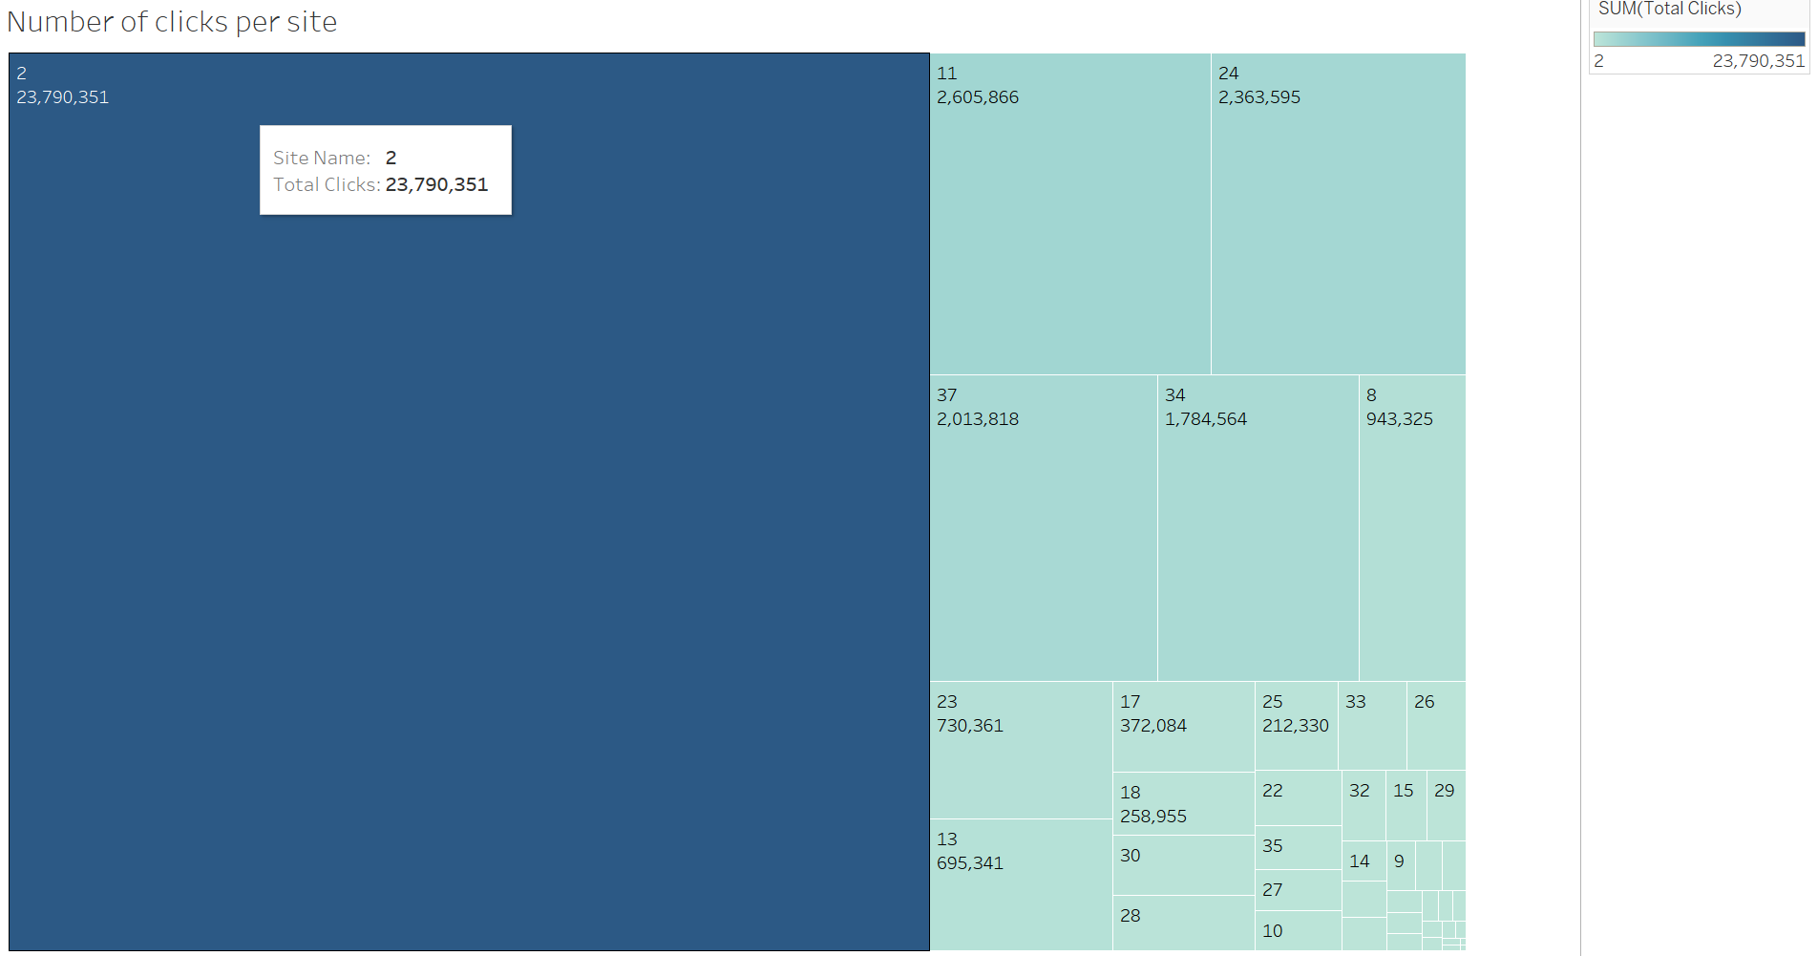
Comparison of Business from various Expedia sites

Slide 11
Application-wide Integration

Slide 12
Sentiment Analysis
Rest based API consumed to pull reviews from Expedia Affiliate Network support for community developer per hotel
Designed map reduce job to aggregate the score for each hotel
Consumed Stanford NLP to calculate review sentiment score
Stanford utilizes recursive neural network internally
Stanford NLP sensitive enough to realize the context of a user review
Eg: This hotel is NOT GOOD

Slide 13
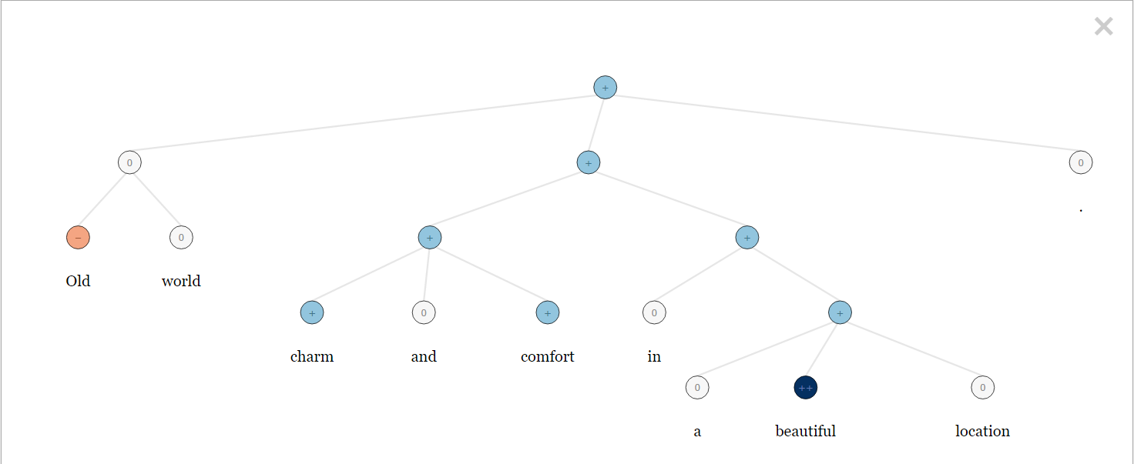
Sentiment Analysis – RCN example - Old world charm and comfort in a beautiful location.

Slide 14
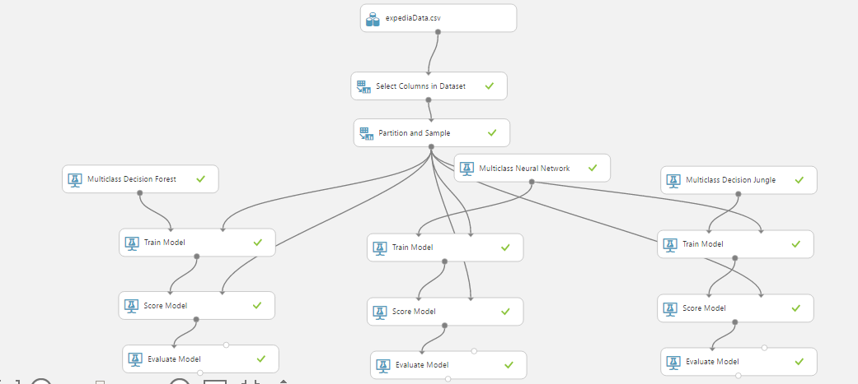
Azure Machine Learning

Slide 15
Machine Learning Statistics
Feature selection
Random forest vs Decision Jungle vs Neural Network
Algorithm | Overall Accuracy(%) | Average Accuracy(%)
Random Forest | 79.36 | 99.5
Decision Jungle | 69.75 | 98.25
Neural Network | 56 | 98.14

Slide 16
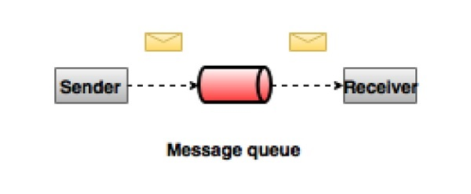
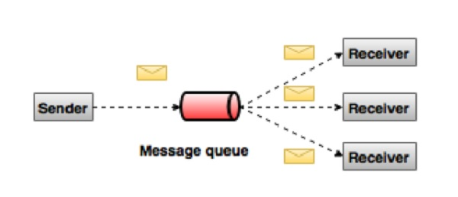
Apache Kafka – Message Queue

Slide 17
Apache Kafka
Distributed streaming platform

Slide 18
Thank you & Questions!!

